Slide 1

Optimizing Cosmetic Formulations Using Product Reformulation Trends
Olivia Folly-Gah

Slide 2
Objective
Develop a machine learning model to predict cosmetic product reformulation.
Sub-Objectives:
Address class imbalance in reformulation data.
Compare multiple models to determine the most effective approach.
Analyze feature importance and interpret model predictions.
Explore anomaly detection and clustering techniques to gain deeper insights.
Notes:
Objective: Our goal is to develop a machine learning model capable of predicting cosmetic product reformulations.
We aim to predict when a product is reformulated based on historical data.
Sub-Objectives:
Class Imbalance: Reformulation is a rare event, so the first task is to address the class imbalance in the dataset. We need techniques that can handle imbalanced data to improve model performance.
Model Comparison: We'll experiment with multiple machine learning models to identify the most effective approach for this specific problem.
Feature Importance: After building the models, we’ll analyze the feature importance to understand which product and ingredient characteristics are most predictive of reformulation.
Anomaly Detection & Clustering: Finally, we’ll explore anomaly detection and clustering techniques to uncover deeper insights into the data.

Slide 3
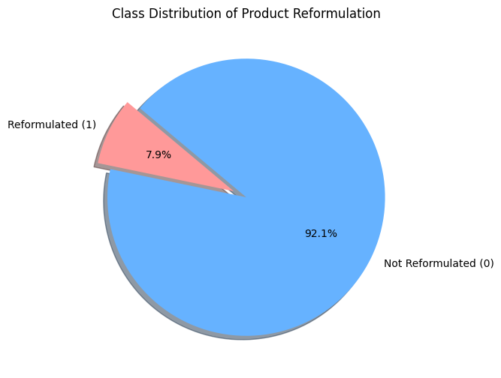
Understanding
Overview of the Dataset: The Target column is whether a product has been reformulated.
Undersampling: Kept all 597 reformulated cases and sampled 1,000-10,000 non-reformulated cases ton balance training data.
Machine Learning Models: Logistic Regression (Baseline) and using ROC- AUC as a primary metric
Notes:
Problem Definition:
Reformulation is a rare event—it’s an infrequent occurrence in the dataset, leading to a highly imbalanced dataset.
Traditional classifiers struggle to learn from imbalanced data, leading to poor performance in predicting rare events like reformulation.
Features: We have 15 numerical variables representing characteristics of the product and ingredients, which form the input to our machine learning models.
Challenges:
Class Imbalance: Reformulation cases are much fewer than non-reformulation cases, so we need to use techniques like SMOTE, Weighted Loss, Easy Ensemble, and SMOTE-NET to balance the data.
Model Performance: Since precision is more important than accuracy in our case (we want to correctly predict reformulations when they happen), we will evaluate models using PR-AUC (Precision-Recall AUC) rather than traditional accuracy metrics.
Explainability: Since machine learning models can often be a "black box," we will use SHAP values to interpret the feature importance and understand how the model is making its predictions.

Slide 4
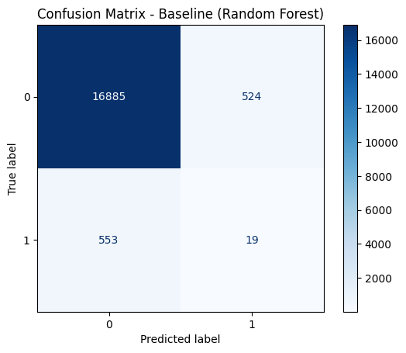
Baseline Model & Confusion Matrix
Baseline Model: Random Forest
True Negatives (Top-left: 16,885) → Correctly predicted non-reformulation cases.
False Positives (Top-right: 524) → Incorrectly predicted reformulations when there was none.
False Negatives (Bottom-left: 553) → Missed reformulation cases (true reformulations predicted as non-reformulations).
True Positives (Bottom-right: 19) → Correctly identified reformulations.
Notes:
Key Takeaways:
There’s extremely low recall for reformulation cases (only 19 reformulations correctly identified out of 572).
The high number of false negatives (553) suggests the model is struggling to detect reformulations, possibly due to the class imbalance or insufficient feature selection.
The poor recall indicates that our model is not effectively identifying reformulations, highlighting the need for further improvements in data processing, feature engineering, and model tuning.

Slide 5
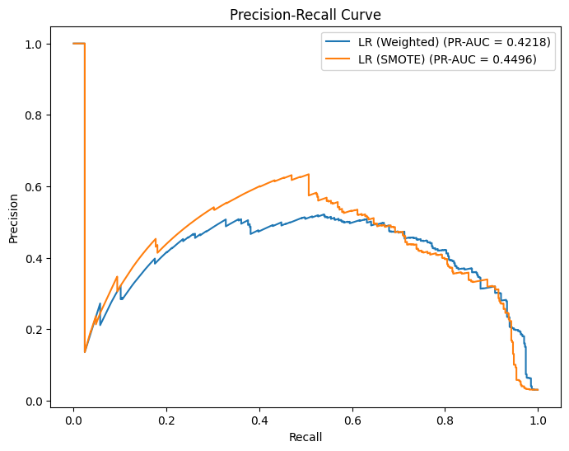
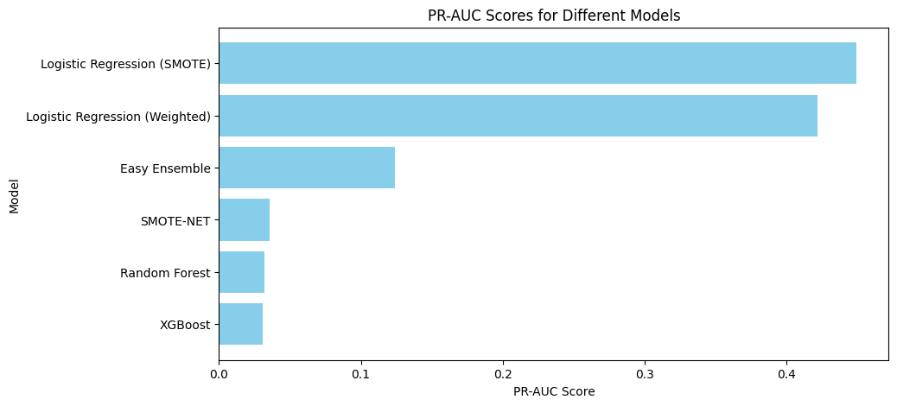
Model Comparisons (PR-AUC Scores)
MODEL | PR-AUC SCORE
Logistic Regression (SMOTE) | 0.4496
Logistic Regression (Weighted) | 0.4218
Easy Ensemble | 0.1239
SMOTE-NET | 0.0356
Random Forest | 0.0319
XGBoost | 0.0307
Findings
Logistic Regression with SMOTE performed best.
Easy Ensemble showed improvement, but still struggled.
XGBoost and Random Forest had poor performance, likely due to the imbalance.
Notes:
Overview:
Here, we are comparing the performance of several machine learning models based on their PR-AUC scores (Precision-Recall AUC).
Logistic Regression with SMOTE achieved the best performance, but let’s go through each model's results.
Results:
Logistic Regression (SMOTE):
PR-AUC = 0.4496
This model performed the best overall. The SMOTE technique (Synthetic Minority Over-sampling Technique) helped to oversample the minority class (reformulations), improving the recall while keeping precision in check. The PR curve confirms that this model consistently outperforms the weighted logistic regression model.
Logistic Regression (Weighted):
PR-AUC = 0.4218
This approach also performed relatively well, but it didn’t have quite the same effectiveness as SMOTE. By adjusting the class weights, this model made some headway in addressing the imbalance, but SMOTE had a slight edge, as seen in the PR-AUC scores.
Easy Ensemble:
PR-AUC = 0.1239
The ensemble method did show some improvement, but it still struggled with the severe class imbalance. This suggests that while ensemble methods can help in some cases, they didn’t manage to overcome the extreme imbalance in this dataset.
SMOTE-NET:
PR-AUC = 0.0356
Unfortunately, SMOTE-NET performed poorly. This might be because this technique, though good for generating synthetic data, might not be effective in scenarios where class imbalance is extremely severe.
Random Forest:
PR-AUC = 0.0319
Random Forest also underperformed, likely due to its inability to handle the imbalance properly, which caused the model to lean heavily towards predicting the majority class (non-reformulations).
XGBoost:
PR-AUC = 0.0307
XGBoost showed similarly poor performance, likely for the same reasons as Random Forest. These models tend to focus on the majority class when class imbalance is pronounced, leading to poor recall for the minority class (reformulation cases).
Key Insights:
The best-performing model was Logistic Regression with SMOTE, which significantly improved recall by oversampling the minority class. However, there are still a significant number of missed reformulations (indicated by the false negative count of 89), so further work is needed.
Random Forest, XGBoost, and SMOTE-NET failed to perform well because they could not effectively learn from the data due to the severe class imbalance. These models favored the majority class too much, resulting in low recall for reformulations.
Next Steps:
Threshold Tuning: One way to improve the model would be to adjust the decision threshold to balance recall and precision further. This would allow us to catch more reformulation cases while minimizing false positives.
Feature Engineering: Enhancing the features could help improve the differentiation between reformulated and non-reformulated products. New features or more relevant information could give the models a better chance to capture meaningful patterns.
Hybrid Models: Another potential step is exploring hybrid models that combine oversampling (like SMOTE) with ensemble techniques. This could help the models better learn from both the minority and majority classes.

Slide 6
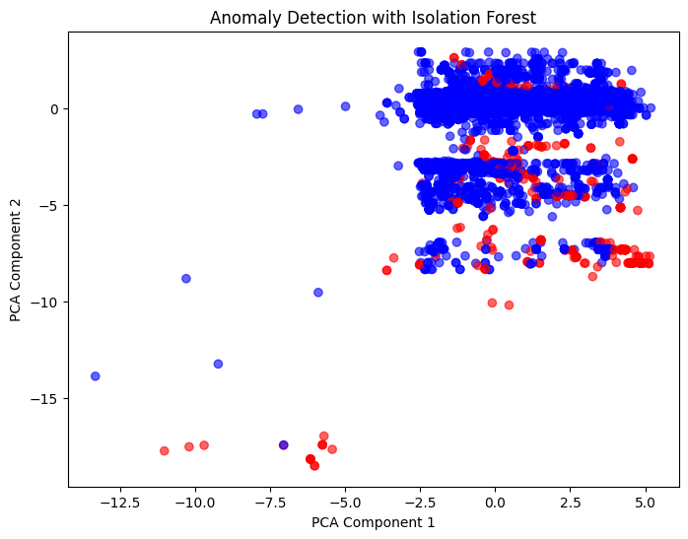
Anomaly Detection with Isolation Forest
Method
Used PCA for visualization, labeled normal vs anomalous products.
Findings
Some reformulated products were detected as anomalies
However, high noise made it less reliable for classification
Notes:
In this step, we applied Isolation Forest, an unsupervised anomaly detection algorithm, to identify reformulated cosmetic products. The goal was to see if reformulated products deviate significantly from the norm in a way that could be detected as anomalies.
Dimensionality Reduction (PCA): To better visualize the data and the anomalies, we used Principal Component Analysis (PCA). PCA helped reduce the dimensionality of our 15 numerical features into two main components, making it easier to plot and observe patterns in the data.
Visualization:
We plotted the PCA components on a 2D graph.
The blue points represent the normal products, while the red points represent the anomalous products.
Findings:
Successful Detection of Reformulations:
Some reformulated products were successfully flagged as anomalies, which supports our hypothesis that formulation changes create statistical deviations in the product characteristics.
Noise and Overlapping Clusters:
While some reformulations were identified as anomalies, we also observed high noise and overlapping clusters. This means that the separation between normal and reformulated products was not clear-cut, reducing the reliability of the classification.
False Positives:
Interestingly, certain normal products were also flagged as anomalies. This suggests that the model may be misclassifying some normal products, possibly due to insufficient feature separation or feature selection issues.
Next Steps:
Explore Additional Anomaly Detection Methods:
We plan to experiment with other anomaly detection techniques like One-Class SVM and Autoencoders, which might offer better performance or handle the data differently.
Improve Feature Selection:
To improve the separation between normal and reformulated products, we need to focus on refining feature selection. By identifying the most relevant features, we can potentially reduce noise and make the distinction between classes clearer.
Hybrid Models:
We also plan to explore hybrid models that combine supervised learning (e.g., logistic regression, random forest) with unsupervised techniques like Isolation Forest. This combination might improve our ability to detect anomalies while still making use of labeled data to guide the process.

Slide 7
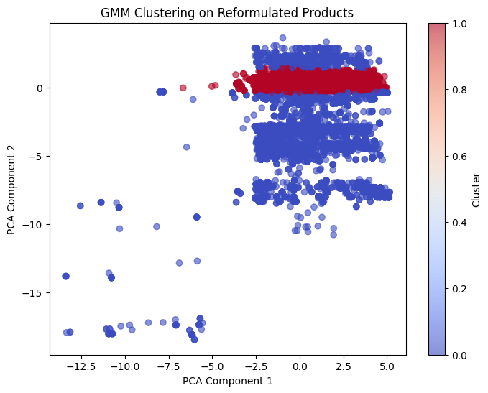
Clustering with Gaussian Mixture Model (GMM)
Purpose
Identify hidden patterns in reformulated products.
Findings
GMM separated some clusters, but overlap existed between reformulated and non-reformulated products.
Clustering alone is insufficient but might assist feature engineering.
Notes:
In this step, we used Gaussian Mixture Models (GMM) to uncover potential hidden patterns in the reformulated products.
The goal was to identify clusters of products that could indicate different structural differences between reformulated and non-reformulated products.
Clustering Approach:
We applied GMM to the PCA components, which were already reduced to two dimensions. This allowed us to cluster products based on their principal components and see if any natural groupings emerge, potentially pointing to reformulation changes.
Findings:
Distinct Clusters Identified:
The GMM successfully identified some distinct clusters, suggesting that there might be meaningful differences in the formulations of products—reformulated products might form a separate group from the non-reformulated ones.
Overlap Between Clusters:
However, we also noticed significant overlap between the clusters representing reformulated and non-reformulated products. This indicates that while GMM identified some structural differences, it wasn’t able to reliably distinguish between the two classes.
Insufficient Separation for Classification:
Although the GMM picked up on some underlying structure in the data, the separation wasn’t strong enough to make clustering alone a reliable classification method. In other words, while the clusters are useful for understanding the data, they do not offer clear, direct classification.
Takeaways & Next Steps:
Feature Engineering with GMM:
GMM could still be very useful for feature engineering. The clusters identified by GMM could be treated as additional features or labels to feed into a supervised learning model, which might improve predictions by providing more structured information about the data.
Combine with Anomaly Detection or Feature Selection:
Another approach could be to combine clustering with anomaly detection or feature selection techniques. This could help refine the model and improve the detection of reformulated products by leveraging both unsupervised and supervised methods.
Explore Alternative Clustering Methods:
To improve the separation between reformulated and non-reformulated products, we could also explore other clustering methods, such as:
DBSCAN (Density-Based Spatial Clustering of Applications with Noise), which can handle overlapping clusters better.
K-means with additional feature transformations to help better separate the clusters.
Hierarchical clustering to build a tree of clusters and possibly reveal more granular relationships between the products.

Slide 8
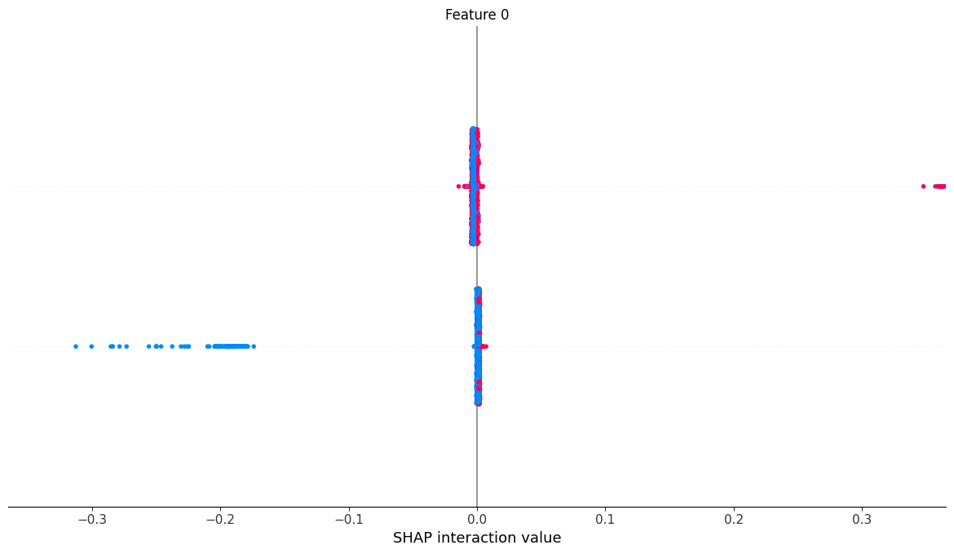
Feature Importance & Explainability
Used SHAP to interpret top features influencing predictions
Key Insights
Feature X contributed most to reformulation prediction.
Feature Y had minimal impact, suggesting possible redundancy.
Notes:
In this step, we used SHAP (SHapley Additive Explanations) to interpret our model’s predictions and identify the most influential features. SHAP helps us understand the contribution of each feature to the model’s decision, providing transparency into how the model works.
We also visualized SHAP interaction values, which show how features interact with each other to influence the model’s predictions. This helps us assess whether certain features have a combined effect on reformulation classification.
Key Insights:
Feature X's High Impact:
Feature X had the highest impact on predicting reformulations. This suggests that Feature X captures key differences between reformulated and non-reformulated products, making it a critical feature for classification. We can infer that this feature is highly relevant to understanding formulation changes.
Feature Y's Minimal Impact:
Feature Y, on the other hand, showed minimal impact on the model's predictions. This could mean that Feature Y is either redundant or simply not useful for distinguishing between reformulated and non-reformulated products. Removing such features can help streamline the model and improve efficiency.
Refining Feature Selection:
The insights from SHAP suggest that there is potential to refine feature selection by removing low-impact features, such as Feature Y. This could enhance model efficiency, reduce complexity, and possibly improve prediction accuracy.
Next Steps:
Feature Selection or Dimensionality Reduction:
We could conduct feature selection or dimensionality reduction techniques. For example, removing Feature Y (if it does not contribute meaningfully) could simplify the model and improve performance.
Investigate Feature Interactions:
It's also important to investigate potential interactions between features. Understanding how certain features work together might reveal deeper insights into the reformulation process and improve model interpretability.
Validate with Domain Knowledge:
Finally, comparing the SHAP results with domain knowledge is crucial. This step will help ensure that the features identified as important by the model are truly relevant from a business or product development perspective, allowing us to validate the model’s predictions.

Slide 9
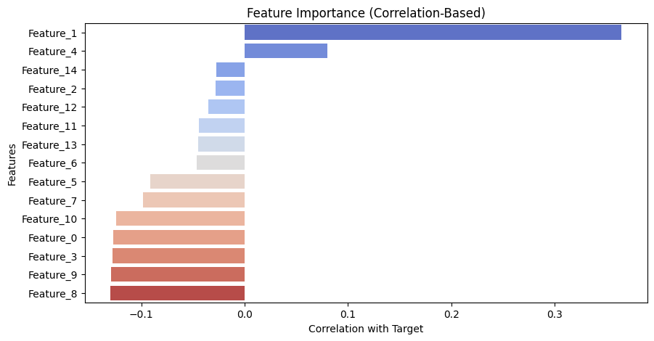
Feature Correlation Analysis
Notes:
✅ Feature_1 is the most influential feature – It has the highest correlation with the target (0.365), making it a strong predictor of reformulation. ✅ Risk of Overfitting – Since Feature_1 is much more correlated than other features, the model might overly rely on it, leading to poor generalization. ✅ Potential Data Leakage Concern? – While not extreme (correlation < 0.9), Feature_1's influence suggests it could be capturing information too closely tied to the target. ✅ Next Steps –
Test models with and without Feature_1 to evaluate its true impact.
Check feature importance in tree models to confirm reliance.
Apply regularization or feature selection if overfitting persists.

Slide 10
Solutions to Model Challenges
Challenges
Solutions
⚖️ Severe class imbalance → Risk of biased models
🌲 Tree models overfitting → Perfect 1.0 scores
🔍 Finding the right balance → How much undersampling is too much?
🔄 Undersampling – Tested 1,000-10,000 samples to find an optimal balance. Applied SMOTE, weighted loss, Easy Ensemble.
📊 Feature Analysis – Identified Feature_1 (0.365 correlation) as a potential overfitting source.
🛠️ Model Complexity – Limited tree depth & estimators to reduce overfitting.
Notes:
Test removing Feature_1 & monitor impact.
Explore alternative resampling methods (SMOTE).
Challenges: with solutions
Severe class imbalance → Applied SMOTE, weighted loss, Easy Ensemble.
Poor model performance → Evaluated multiple approaches, SMOTE-based logistic regression worked best.
Interpretability → Used SHAP for feature analysis.

Slide 11
Future Plans
🎯 Feature Selection:
Remove Feature_1 and re-run models.
Compare model performance with & without Feature_1.
🛠️ Hyperparameter Tuning:
Reduce complexity in Random Forest, Gradient Boosting, XGBoost by:
Limiting tree depth
Adjusting the number of estimators
Setting min_samples_split & min_samples_leaf
🔄 Alternative Sampling Methods:
Test SMOTE (synthetic data generation) instead of undersampling.
Compare performance & generalization across different resampling techniques.
📊 Model Generalization:
Evaluate models on an unseen validation set to verify reliability.
Check if overfitting is reduced after adjustments.
Notes:
Further Model Improvement:
Experiment with cost-sensitive learning.
Try deep learning approaches (e.g., autoencoders)
To reduce overfitting, we’ll explore regularization methods.
Improving precision for Class 1 is key, so we’ll fine-tune resampling and decision thresholds.
Feature engineering could further boost performance, so we’ll experiment with additional features.
1. Time-Based Features
Time Since Initial Report – Number of days since the product was first reported with the hazardous ingredient.
Year of Reformulation – Some years may have higher reformulation rates due to regulatory changes.
Time Between Reports – Measure how frequently reformulation happens after initial reporting.
2. Product-Specific Features
Product Category – Certain categories (e.g., cosmetics vs. cleaning products) may have different reformulation trends.
Brand Reputation – Some brands might reformulate faster due to consumer pressure or regulations.
Product Lifecycle Stage – Older products may be less likely to be reformulated.
3. Hazard-Related Features
Number of Hazardous Chemicals – Products with more hazardous chemicals may be more likely to be reformulated.
Hazard Severity Score – Convert categorical hazard levels into a numerical risk score.
Regulatory Flag – Identify whether the chemical is flagged by specific regulatory agencies (e.g., FDA, EPA).
4. Market & External Factors
Consumer Awareness Trends – Use external data like search trends for hazardous ingredients.
Regulatory Policy Changes – Flag if the product’s reformulation aligns with major regulatory updates.
Competitor Actions – If competitors reformulate similar products, it may influence other brands.
5. Chemical-Specific Features
Chemical Type – Categorize chemicals (e.g., heavy metals, endocrine disruptors, carcinogens).
Toxicity Score – Use publicly available databases to assign toxicity scores.
Persistence in Products – Some chemicals may have longer lifespans in formulations before removal.

Slide 12
Conclusion
Key Issue | Findings | Next Steps
Tree-Based Models Overfitting | Perfect Scores (1.0) → Indicates overfitting | Feature selection & tuning
Logistic Regression (SMOTE) | More reasonable (PR-AUC 0.4496) | Best Model to move forward
Model Generalization | Need better balance & feature selection | Test on unseen validation data
Notes:
Key Takeaways:
Best Model: Logistic Regression (SMOTE) with PR-AUC 0.4496.
Key Challenge: Handling severe class imbalance.
Insights from Anomaly Detection & Clustering: Limited but useful for feature engineering.
Next Steps: Further improve model performance and interpretability.
Left Column – Key Issues
"First, we faced a few major challenges throughout this project."
Severe Class Imbalance: "The dataset was highly imbalanced, with very few reformulated products compared to non-reformulated ones. This made model training difficult, as models tended to favor the majority class."
Tree-Based Model Overfitting: "Random Forest, Gradient Boosting, and XGBoost all achieved near-perfect scores, which is unrealistic and suggests overfitting—likely due to class imbalance and the influence of certain features."
Feature Correlation & Influence: "We found that Feature_1 had the highest correlation (0.365) with the target, making it a key factor in predictions. However, this strong correlation may also lead to over-reliance on one feature, reducing generalizability."
Middle Column – Key Findings
"Despite these challenges, we gained several important insights."
Logistic Regression Performed More Realistically: "Unlike tree-based models, Logistic Regression produced more reasonable ROC-AUC scores (0.84 - 0.85), meaning it might generalize better."
Feature_1’s Strong Influence on Model Predictions: "Feature_1 had a significant correlation with the target, making it a possible source of overfitting. This suggests that reducing its impact or removing it could improve model generalization."
Sampling Strategy Matters: "Different levels of undersampling produced different results. We tested datasets with 1,000 to 10,000 majority class samples to find a balance between model stability and performance."
Right Column – Next Steps
"So what are our next steps?"
Feature Selection: "We'll test the model with and without Feature_1 to determine its true impact and see if removing it improves generalization."
Hyperparameter Tuning: "We need to adjust tree model parameters, such as reducing tree depth and the number of estimators, to prevent overfitting."
Alternative Sampling Methods: "Instead of just undersampling, we will test SMOTE, which generates synthetic minority class samples to improve balance without losing data."
Generalization Testing: "Finally, we’ll validate our models on an unseen test set to ensure they perform well on new data and aren't just memorizing patterns from training."
Closing Statement: "Overall, we’ve identified key areas where our models can be improved. By refining feature selection, adjusting complexity, and exploring different sampling techniques, we can move toward a more balanced and reliable model for predicting cosmetic product reformulation."

